Slide 1
Migration and family living arrangements in China
Sylvie Démurger (CNRS, GATE Lyon Saint-Etienne & IZA, Bonn)
Shi Li (Business School, Beijing Normal University & IZA, Bonn)
Hui Xu (Business School, Beijing Normal University)
Very preliminary-Work in progress

Slide 2
Context
Unprecedented large-scale labor migration within China: 168 million rural migrant workers in 2014.
(外出农民工)

Slide 3
Context
In theory:
Individuals can decide whether to migrate or not, and if they migrate, decide on their length of stay in cities.
In practice:
Temporary migration dominates.
Partly due to strong institutional constraints imposed by the household registration system (hukou)
Access to public services in cities deeply tied to the hukou.
A key restriction: access to education for migrant children
Rural migrant children not officially denied access to urban public school system, but parents requested to pay “education endorsement fees”.
At high-school level, students requested to take the university entrance exam in their hukou registration area.

Slide 4
Context
Consequences on family living arrangements:
Migrants migrate alone and leave part of their family behind: their spouse, their children, and/or their parents.

Slide 5
Context
2010 Census: Estimated number of children left behind in rural areas by at least one migrant parent: 61 million
37.7% of the total population of rural children
21.9% of the total population of children nationwide
Among left-behind children, 47% have two migrant parents, 36% have a migrant father, and 17% have a migrant mother.
Estimated 47 million wives and 45 million elderly also left behind in the countryside by their migrant family member(s) (Ye, Wang, Wu, He & Liu, 2013).
In 2011, among school-age children of migrant workers:
12.6 million were attending schools for compulsory education in cities
22 million left-behinds were attending schools for compulsory education in rural areas (Ministry of Education).

Slide 6
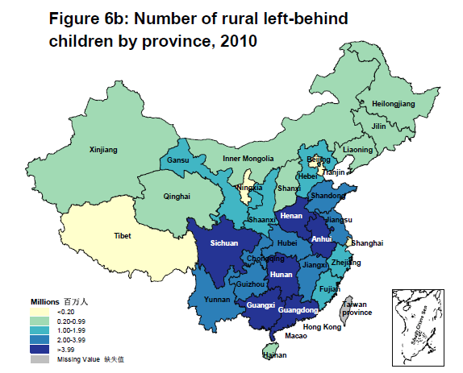
Context
Source: UNICEF (2013); National Bureau of Statistics, 2010 Population Census.

Slide 7
Impact of migration on left-behind children
Available evidence:
Negative impact of parental migration on the well-being of the left-behinds, especially in terms of educational and health outcomes as well as psychosocial behavior
e.g. Chen et al., 2009; Gao et al., 2010; Gong et al., 2008; Kong & Meng, 2010; Lee, 2011; Lee & Park, 2010; Meng & Yamauchi, 2012.
Positive impact from remittances on child schooling, health and child labor.
International evidence: e. g. Cox Edward and Ureta, 2003; Adams & Cuecuecha, 2010; Yang, 2008
China case: e.g. Hu (2013)
Effects may differ based on age and gender of the child
Meyerhoefer &Chen, 2011; Lee & Park, 2010; Zhou et al.,2014; Hu,2013
Effects may differ with different family arrangements
Zhang et al. (2013); Zhou et al. (2014); Lu (2012)

Slide 8
This paper
Factors that are related to family arrangements for migrants are rather unexplored.
Yet important to understand migrants’ family arrangement and how the decision is correlated to various individual, family and institutional factors.
Our objective:
Describe the current living arrangements of migrants in China
Account for variations along several dimensions.
Sub-questions: is there a gender bias (son’s preference?) / is there an age-of-the-child bias?

Slide 9
Migration and family living arrangements
Early literature: Mincer two-person family model (1978)
The whole family migrates if the total gain is positive, and stays otherwise (tied movers / tied stayers)
Having school-age children may inhibit family migration as it usually increases the costs of geographical mobility. Having pre-school children may accelerate the family migration for prospective schooling of children in the future.
NELM: migration as a household level decision
Decision to split the family based on the comparison between expected economic profits and the emotional sacrifice for both migrant parents and their children
May depend on family structure in terms of size and family life-cycle stage, family ties to the place of origin, the socio-economic resources of the family, or previous family migration.

Slide 10
Potential reasons for family separation in China
Institutional constraints:
Urban-based schooling, health care, housing and social security are excluding rural migrants because of the Hukou.
The education system requires students to take the entrance examination for university at their Hukou registered province. Because the school curriculum differs in different provinces, in many cases migrants have to leave their high school aged children behind.
Cultural characteristics:
Co-residing with grandparents (Zeng & Xie, 2014): Having grandparents at home may free the parents to migrate and leave behind their children at home with their grandparents.

Slide 11
Research question
How much of the decision regarding family living arrangement stems from individual (or family) choice versus institutional constraints?
Migrant individual characteristics
Family size and (gender and age) composition
Conditions at destination
Characteristics at origin.

Slide 12
Data
Dynamic monitoring survey of migrant population in urban China 2011, National Population and Family Planning Commission (NPFPC Migrant Survey).
Coverage:
31 provinces, 326 cities, 5,850 communities,
128,000 migrant households (20 migrant households randomly chosen for each community).
Only one member aged 16-59 from each household chosen to answer the survey.
Range of household samples: 2,000 in the least populous provinces (Ningxia, Qinghai, Tibet, Jilin) to 10,000 in Guangdong province.
A series of questions about family composition and living arrangements.

Slide 13
Sample representativeness
 | Census 2010 | NPFPC Migrant Survey 2011
Number of migrants | 260,937,942 | 127,899
Urban migrants | 26% | 15.2%
Rural migrants | 74% | 84.8%
Gender (male=1) | 0.52 | 0.53
Education
Illiterate | 1.9% | 1.8%
Primary school | 16.4% | 14.7%
Junior middle | 41% | 55%
High middle | 22.7% | 20.7% (15.1% high school +5.6% tech-prof)
College | 9.9% | 5.2%
University | 7.5% | 2.54%
Graduate | 0.6%
Inter-province migration | 32.9% | 50.6%
Sources: NPFPC Migrant Survey2011 and Tabulation data from the 6th China Population Census (2010).

Slide 14
Data
Focus on married migrants with at least 1 child (below 16).
77.5% of the whole sample of migrants is married
Among them, 71.1% have at least one child
Final sample size: 70,508 observations.
Married migrants with children
 | Mean | Standard deviation
Age | 33.64 | 6.005
Rural origin of migrants | 0.871 | 0.335
# children less than 16 | 1.314 | 0.521
One child | 0.712 | 0.453
Two children | 0.265 | 0.441
Three children and more | 0.0234 | 0.151
Any school-age child | 0.631 | 0.483
Any infant | 0.497 | 0.500
Any son | 0.669 | 0.471
Any daughter | 0.521 | 0.500

Slide 15
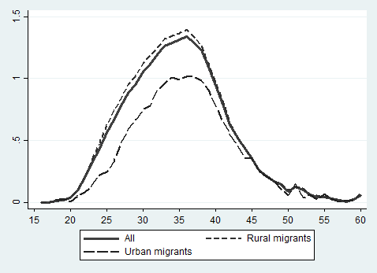
Average number of children by age and hukou status

Slide 16
Leaving children behind
 | Mean | Standard deviation
Any left-behind child | 0.311 | 0.463
Any left-behind school-age child | 0.329 | 0.470
Any left-behind infant | 0.262 | 0.440
Any left-behind son | 0.302 | 0.459
Any left-behind daughter | 0.300 | 0.458
Any left-behind school-age son | 0.313 | 0.463
Any left-behind school-age daughter | 0.316 | 0.465
Any left-behind infant son | 0.259 | 0.438
Any left-behind infant daughter | 0.249 | 0.432
Sample size | 70,508
Key raw statistics:
No gender bias
BUT differences across children age groups

Slide 17
Types of family living arrangements
 | Total | Rural migrants | Urban migrants
Whole family in city (migrant + spouse + children) | 65.98% | 65.54% | 68.91%
Parents only in city | 17.94% | 18.57% | 13.72%
Parents in city with separated children (some in city / some left behind) | 3.35% | 3.62% | 1.50%
One parent only in city | 9.5% | 9.33% | 11.14%
One parent in city with child(ren) | 2.95% | 2.70% | 4.64%
Sample size | 70,508 | 61,429 | 9,079

Slide 18
Characteristics by children’s residence
 | Married migrants with children in city |  | Married migrants with left-behind children
 | Mean | Standard deviation | Mean | Standard deviation
Rural origin of migrants | 0.863 | 0.344 | 0.890 | 0.312
Spouse in city | 0.957 | 0.202 | 0.685 | 0.464
Parents in city | 0.0419 | 0.200 | 0.00908 | 0.0949
Inter-province migration | 0.454 | 0.498 | 0.633 | 0.482
Inter-city in a province | 0.334 | 0.472 | 0.251 | 0.434
Inter-county in a city | 0.212 | 0.408 | 0.117 | 0.321
1-year stay in current place | 0.0867 | 0.281 | 0.183 | 0.387
2-year stay in current place | 0.145 | 0.352 | 0.194 | 0.395
3-year stay in current place | 0.136 | 0.342 | 0.145 | 0.352
Monthly individual income | 2,589.1 | 1,810.5 | 2,441.1 | 1,095.2
Monthly household income | 4,730.3 | 5,148.0 | 4,290.0 | 4,574.9
Yearly remittances | 2,186.9 | 4,643.8 | 5,383.3 | 7,445.3
Remittances as a share of household income | 0.0415 | 0.0768 | 0.122 | 0.161
Sample size | 48,596 |  | 21,912

Slide 19
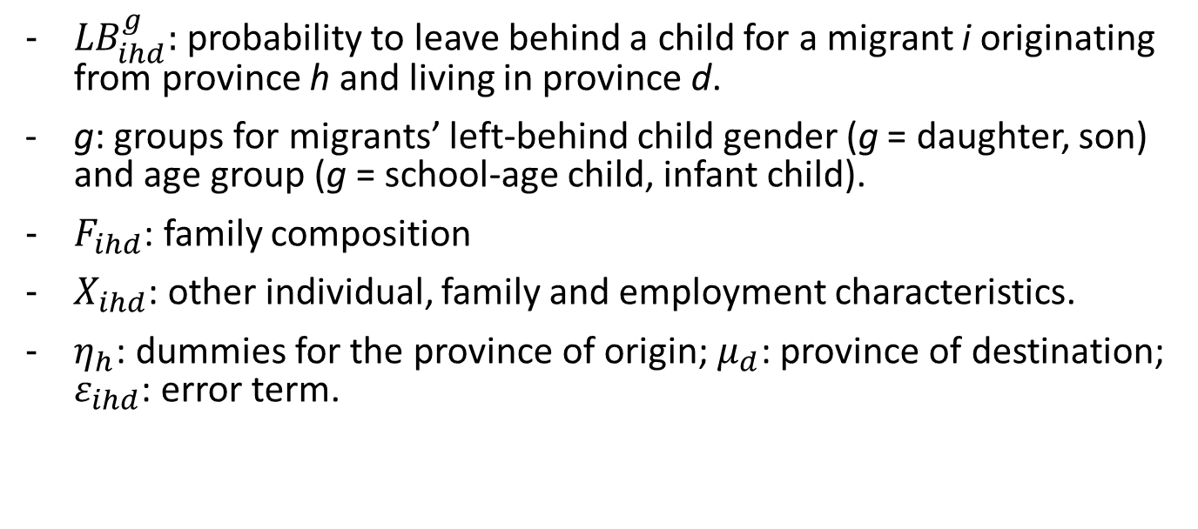
Empirical approach
Probit model
$${LB}_{ihd}^{g}=α^{g}F_{ihd}+β^{g}X_{ihd}+η_{h}+μ_{d}+ε_{ihd}$$
${LB}_{ihd}^{g}:$ probability to leave behind a child for a migrant i originating from province h and living in province d.
g: groups for migrants’ left-behind child gender (g = daughter, son) and age group (g = school-age child, infant child).
$F_{ihd}$: family composition
$X_{ihd}$: other individual, family and employment characteristics.
$η_{h}$: dummies for the province of origin; $μ_{d}$: province of destination; $ε_{ihd}$: error term.

Slide 20
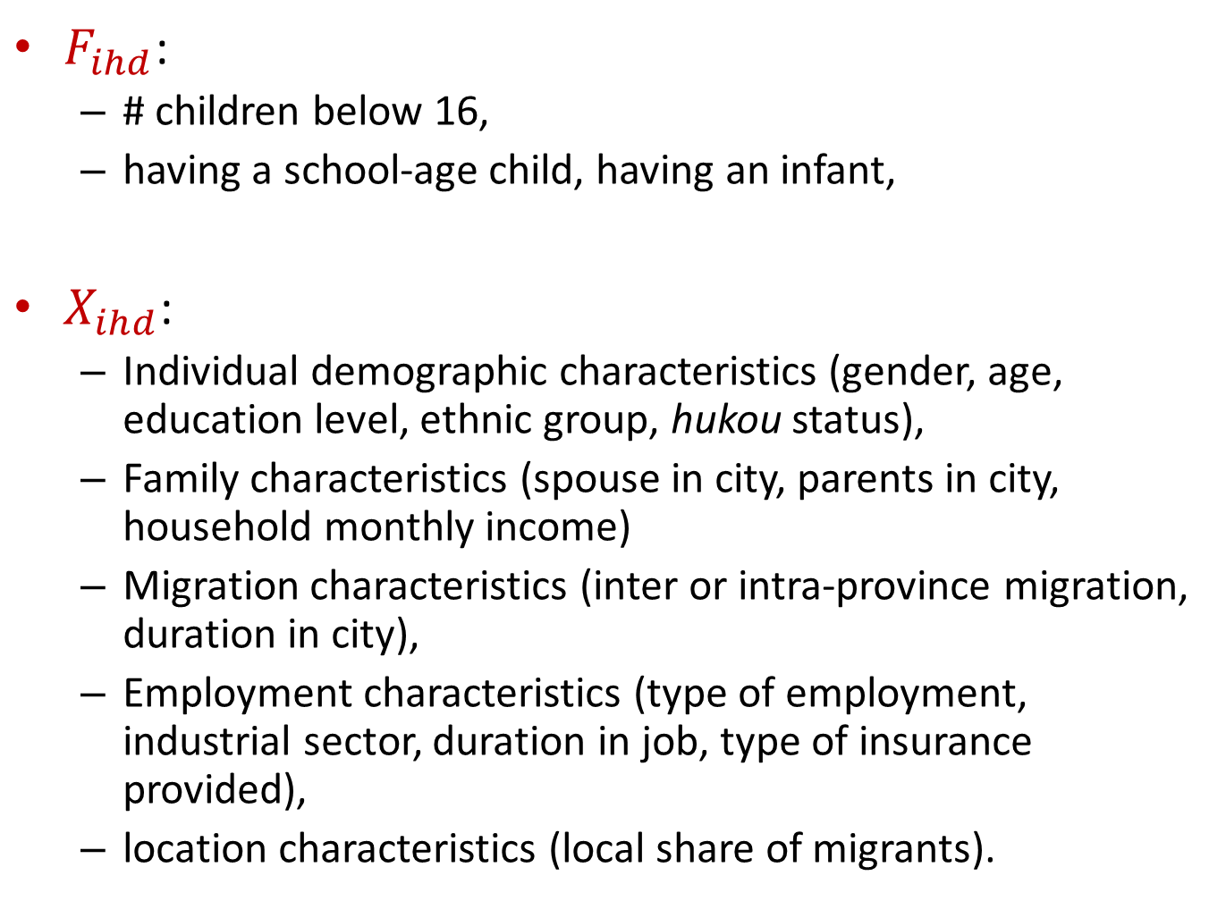
$F_{ihd}$:
# children below 16,
having a school-age child, having an infant,
$X_{ihd}$:
Individual demographic characteristics (gender, age, education level, ethnic group, hukou status),
Family characteristics (spouse in city, parents in city, household monthly income)
Migration characteristics (inter or intra-province migration, duration in city),
Employment characteristics (type of employment, industrial sector, duration in job, type of insurance provided),
location characteristics (local share of migrants).

Slide 21
Probit estimates for leaving behind children - Baseline analysis
Dependent variable | (1) | (2) | (3)
Leaving behind a child
# children less than 16 | 0.0900*** (0.00432) |  | 0.0805*** (0.00516)
Two children |  | 0.107*** (0.00532)
Three children and more |  | 0.138*** (0.0158)
Any school-age child |  |  | 0.0587*** (0.00880)
Any infant |  |  | -0.000577 (0.00783)
Observations | 58168 | 58168 | 58168
r2_p | 0.219 | 0.219 | 0.220

Slide 22
Probit estimates for leaving behind children - Baseline analysis
Dependent variable | (1) | (2) | (3)
Leaving behind a child
Male | -0.00996** (0.00459) | -0.00982** (0.00459) | -0.00370 (0.00463)
Age | 0.00380 (0.00344) | 0.00261 (0.00345) | -0.00876** (0.00368)
Age square | -0.0000181 (0.0000496) | -0.00000126 (0.0000497) | 0.000126** (0.0000518)
Han | 0.0285*** (0.00997) | 0.0282*** (0.00997) | 0.0284*** (0.00998)
Below primary | 0.135*** (0.0294) | 0.139*** (0.0294) | 0.118*** (0.0293)
Primary | 0.139*** (0.0216) | 0.139*** (0.0216) | 0.120*** (0.0215)
Junior high | 0.141*** (0.0179) | 0.139*** (0.0179) | 0.124*** (0.0181)
High school | 0.135*** (0.0209) | 0.134*** (0.0208) | 0.120*** (0.0208)
Tech-Prof | 0.0955*** (0.0223) | 0.0949*** (0.0223) | 0.0835*** (0.0222)
Junior college | 0.0373* (0.0217) | 0.0371* (0.0217) | 0.0315 (0.0216)

Slide 23
Probit estimates for leaving behind children - Baseline analysis
Dependent variable | (1) | (2) | (3)
Leaving behind a child
Rural origin of migrants | 0.00907 (0.00729) | 0.00827 (0.00730) | 0.00734 (0.00731)
Spouse in city | -0.507*** (0.00582) | -0.507*** (0.00582) | -0.506*** (0.00583)
Parents in city | -0.251*** (0.00691) | -0.251*** (0.00692) | -0.250*** (0.00696)
Inter-province migration | 0.149*** (0.00734) | 0.149*** (0.00734) | 0.149*** (0.00734)
Inter-city in a province | 0.0617*** (0.00748) | 0.0616*** (0.00748) | 0.0619*** (0.00748)
Duration in this city | -0.0153*** (0.000614) | -0.0153*** (0.000614) | -0.0155*** (0.000615)
Log(monthly hh income) | -0.0160*** (0.00430) | -0.0162*** (0.00430) | -0.0159*** (0.00430)

Slide 24
Probit estimates for leaving behind children - Baseline analysis
Dependent variable | (1) | (2) | (3)
Leaving behind a child
Duration in current job | -0.00181*** (0.000666) | -0.00184*** (0.000667) | -0.00196*** (0.000667)
Employer (d) | -0.00461 (0.00787) | -0.00451 (0.00788) | -0.00438 (0.00788)
Housework (d) | -0.0249 (0.0158) | -0.0256 (0.0158) | -0.0237 (0.0159)
Employee (d) | 0.0551*** (0.00575) | 0.0556*** (0.00575) | 0.0553*** (0.00576)

Slide 25
Probit estimates for leaving behind children - Baseline analysis
Dependent variable | (1) | (2) | (3)
Leaving behind a child
Manufacturing | 0.0966*** (0.00996) | 0.0960*** (0.00996) | 0.0962*** (0.00997)
Construction | 0.00882 (0.0104) | 0.00836 (0.0104) | 0.00902 (0.0104)
Electricity/coal/water | 0.0412 (0.0304) | 0.0404 (0.0304) | 0.0404 (0.0304)
Wholesale and retail | 0.0142 (0.00879) | 0.0137 (0.00879) | 0.0140 (0.00880)
Hotel and catering | 0.109*** (0.0105) | 0.109*** (0.0105) | 0.108*** (0.0105)
Social services | 0.0100 (0.0102) | 0.00967 (0.0102) | 0.0104 (0.0102)
Finance/Insurance/Real estate | -0.0375 (0.0258) | -0.0375 (0.0258) | -0.0366 (0.0258)
Transport, storage and communication | -0.0475*** (0.0118) | -0.0482*** (0.0118) | -0.0479*** (0.0118)
Health, sports and social welfare | 0.0385 (0.0261) | 0.0380 (0.0261) | 0.0414 (0.0262)
Education, Culture, Film and Television | -0.0843*** (0.0248) | -0.0847*** (0.0248) | -0.0815*** (0.0250)

Slide 26
Probit estimates for leaving behind children - Baseline analysis
Province of origin – fixed effects – Reference: Sichuan
Beijing | -0.124 (0.125) | Zhejiang | -0.00866 (0.0149) | Hainan | -0.117*** (0.0225)
Tianjin | -0.0812 (0.0916) | Anhui | -0.0371*** (0.0116) | Chongqing | 0.0246* (0.0145)
Hebei | -0.0652*** (0.0148) | Fujian | -0.0688*** (0.0141) | Guizhou | -0.102*** (0.0131)
Shanxi | -0.0657*** (0.0189) | Jiangxi | 0.0170 (0.0138) | Yunnan | -0.00978 (0.0191)
Inner Mongolia | -0.187*** (0.0151) | Shandong | -0.0477*** (0.0135) | Tibet | -0.0864** (0.0392)
Liaoning | -0.0643*** (0.0239) | Henan | -0.0267** (0.0114) | Shaanxi | -0.0547*** (0.0156)
Jilin | -0.0941*** (0.0211) | Hubei | -0.00186 (0.0133) | Gansu | -0.0597*** (0.0147)
Heilongjiang | -0.113*** (0.0160) | Hunan | -0.00954 (0.0131) | Qinghai | -0.0662** (0.0270)
Shanghai | -0.211** (0.0950) | Guangdong | -0.0766*** (0.0148) | Ningxia | -0.128*** (0.0245)
Jiangsu | 0.0442*** (0.0165) | Guangxi | -0.0796*** (0.0160) | Xinjiang | -0.0311 (0.0261)

Slide 27
Probit estimates for leaving behind children - Baseline analysis
Province of destination – fixed effects – Reference: Beijing
Tianjin | -0.0673*** (0.0146) | Anhui | -0.144*** (0.0139) | Chongqing | -0.0421** (0.0189)
Hebei | -0.0307* (0.0175) | Fujian | 0.0439** (0.0187) | Sichuan | 0.0186 (0.0200)
Shanxi | -0.0970*** (0.0171) | Jiangxi | -0.00630 (0.0188) | Guizhou | -0.0804*** (0.0174)
Inner Mongolia | -0.135*** (0.0176) | Shandong | -0.0488*** (0.0166) | Yunnan | -0.0266 (0.0182)
Liaoning | -0.108*** (0.0175) | Henan | -0.00347 (0.0183) | Tibet | 0.173*** (0.0309)
Jilin | -0.0807*** (0.0236) | Hubei | -0.131*** (0.0147) | Shaanxi | -0.0101 (0.0190)
Heilongjiang | -0.0590*** (0.0223) | Hunan | 0.00528 (0.0204) | Gansu | -0.0273 (0.0179)
Shanghai | 0.0521*** (0.0176) | Guangdong | 0.0418*** (0.0157) | Qinghai | 0.0478** (0.0232)
Jiangsu | 0.0946*** (0.0170) | Guangxi | -0.108*** (0.0166) | Ningxia | -0.119*** (0.0178)
Zhejiang | 0.0940*** (0.0168) | Hainan | -0.148*** (0.0145) | Xinjiang | -0.126*** (0.0145)

Slide 28
Main findings
Leaving a child behind:
Not a matter of being rural rather than urban migrant;
Having more than one child significantly increases the probability to leave them behind, especially for children of school-age: education seems to be a strong constraint;
Less educated migrants more likely to leave behind their children;
Having a spouse / parent in city reduces the probability to leave a child behind, as does a longer experience as a migrant, and shorter distance migration;
Job characteristics important as well: being an employee increases the probability to leave a child behind, as does employment in time demanding sectors (manufacturing, hotel and catering).
Coastal destination province as important constraint.

Slide 29
Probit estimates for leaving behind children – By child gender and by child age
Dependent variable | (1) | (2) | (3) | (4)
Leaving behind a child | of school age | infant | son | daughter
One child | -0.110*** (0.00414) | -0.0987*** (0.00362) | -0.0958*** (0.00435) | -0.195*** (0.00434)
Spouse in city | -0.323*** (0.00674) | -0.180*** (0.00559) | -0.321*** (0.00639) | -0.207*** (0.00592)
Parents in city | -0.128*** (0.00529) | -0.0735*** (0.00226) | -0.143*** (0.00572) | -0.111*** (0.00415)

Slide 30
Probit estimates for leaving behind children – By child gender and by child age
Dependent variable | (1) | (2) | (3) | (4)
Leaving behind a child | of school age | infant | son | daughter
Male | -0.0338*** (0.00355) | 0.0199*** (0.00234) | -0.00964*** (0.00368) | -0.00406 (0.00315)
Age | 0.125*** (0.00305) | -0.0226*** (0.00222) | 0.0161*** (0.00279) | -0.0108*** (0.00235)
Age square | -0.00149*** (0.0000426) | 0.000117*** (0.0000333) | -0.000191*** (0.0000401) | 0.000152*** (0.0000339)
Han | 0.0118 (0.00738) | 0.00600 (0.00520) | 0.0217*** (0.00776) | 0.00630 (0.00682)
Below primary | 0.209*** (0.0336) | -0.0191 (0.0117) | 0.128*** (0.0282) | 0.0216 (0.0200)
Primary | 0.217*** (0.0258) | -0.0222*** (0.00817) | 0.108*** (0.0200) | 0.0327** (0.0154)
Junior high | 0.169*** (0.0151) | -0.0150 (0.00915) | 0.102*** (0.0148) | 0.0329** (0.0128)
High school | 0.186*** (0.0248) | 0.00329 (0.00924) | 0.0988*** (0.0193) | 0.0372** (0.0152)
Tech-Prof | 0.118*** (0.0258) | -0.000635 (0.00952) | 0.0771*** (0.0206) | 0.0233 (0.0159)
Junior college | 0.0471** (0.0226) | 0.00231 (0.00983) | 0.0164 (0.0184) | 0.0227 (0.0160)

Slide 31
Probit estimates for leaving behind children – By child gender and by child age
Dependent variable | (1) | (2) | (3) | (4)
Leaving behind a child | of school age | infant | son | daughter
Rural origin of migrants | 0.00705 (0.00550) | -0.0102** (0.00413) | 0.00729 (0.00586) | -0.00211 (0.00515)
Inter-province migration | 0.102*** (0.00564) | 0.0281*** (0.00402) | 0.0999*** (0.00600) | 0.0546*** (0.00518)
Inter-city in a province | 0.0435*** (0.00601) | 0.0124*** (0.00410) | 0.0445*** (0.00633) | 0.0233*** (0.00534)
Duration in this city | -0.00909*** (0.000444) | -0.00534*** (0.000371) | -0.00955*** (0.000498) | -0.00669*** (0.000428)
Log(monthly hh income) | -0.00945*** (0.00323) | 0.000695 (0.00230) | -0.00551 (0.00344) | -0.00524* (0.00295)

Slide 32
Probit estimates for leaving behind children – By child gender and by child age
Dependent variable | (1) | (2) | (3) | (4)
Leaving behind a child | of school age | infant | son | daughter
Duration in current job | -0.000411 (0.000475) | -0.00127*** (0.000401) | -0.00175*** (0.000538) | -0.000297 (0.000458)
Employer | -0.000860 (0.00594) | -0.00406 (0.00432) | -0.00724 (0.00634) | -0.00244 (0.00553)
Housework | -0.00655 (0.0123) | -0.00658 (0.00849) | -0.0207 (0.0126) | -0.00136 (0.0114)
Employee | 0.0225*** (0.00440) | 0.0254*** (0.00315) | 0.0266*** (0.00467) | 0.0310*** (0.00403)

Slide 33
Probit estimates for leaving behind children – By child gender and by child age
Dependent variable | (1) | (2) | (3) | (4)
Leaving behind a child | of school age | infant | son | daughter
Manufacturing | 0.0478*** (0.00787) | 0.0307*** (0.00585) | 0.0543*** (0.00826) | 0.0421*** (0.00727)
Construction | 0.0139* (0.00797) | -0.00374 (0.00552) | 0.00421 (0.00834) | 0.00814 (0.00733)
Electricity/coal/water | 0.0272 (0.0245) | 0.0140 (0.0177) | -0.00430 (0.0238) | 0.0335 (0.0233)
Wholesale and retail | 0.00605 (0.00666) | 0.00166 (0.00490) | 0.00399 (0.00713) | 0.0104 (0.00632)
Hotel and catering | 0.0646*** (0.00858) | 0.0376*** (0.00658) | 0.0536*** (0.00873) | 0.0643*** (0.00822)
Transport, storage and communication | -0.0308*** (0.00852) | -0.0139** (0.00612) | -0.0300*** (0.00936) | -0.0174** (0.00823)
Education, Culture, Film and Television | -0.0655*** (0.0176) | -0.0127 (0.0126) | -0.0808*** (0.0178) | -0.00865 (0.0188)

Slide 34
Main findings
Migrants with one child only less likely to leave behind their child, and the marginal effect is especially strong for daughter.
Negative marginal effect (on leaving behind a child) of “spouse in city” larger for children of school-age and for sons.
Migrants education significant for school-age children and boys.
Migration distance especially important for school-age children.
Poorer families have a higher probability to leave daughters and school-age children behind than richer families.

Slide 35
Probit estimates for leaving behind children – By child gender and age
Dependent variable | (1) | (2) | (3) | (4)
Leaving behind a: | school-age son | school-age daughter | infant son | infant daughter
One child | -0.0819*** (0.00341) | -0.156*** (0.00364) | -0.0847*** (0.00305) | -0.0917*** (0.00304)
Spouse in city | -0.210*** (0.00589) | -0.123*** (0.00485) | -0.103*** (0.00433) | -0.0787*** (0.00387)
Parents in city | -0.0798*** (0.00442) | -0.0577*** (0.00269) | -0.0409*** (0.00185) | -0.0357*** (0.00170)

Slide 36
Probit estimates for leaving behind children – By child gender and age
Dependent variable | (1) | (2) | (3) | (4)
Leaving behind a: | school-age son | school-age daughter | infant son | infant daughter
Male | -0.0202*** (0.00281) | -0.0137*** (0.00222) | 0.00947*** (0.00172) | 0.00946*** (0.00159)
Age | 0.0842*** (0.00247) | 0.0422*** (0.00195) | -0.00729*** (0.00166) | -0.00697*** (0.00151)
Age square | -0.00103*** (0.0000346) | -0.000497*** (0.0000272) | -0.0000112 (0.0000251) | 0.00000422 (0.0000227)
Han | 0.00710 (0.00584) | 0.00455 (0.00454) | 0.00512 (0.00372) | -0.00125 (0.00373)
Below primary | 0.180*** (0.0340) | 0.0621*** (0.0223) | -0.00520 (0.00961) | -0.0179*** (0.00642)
Primary | 0.167*** (0.0256) | 0.0695*** (0.0178) | -0.00993 (0.00638) | -0.0114** (0.00562)
Junior high | 0.123*** (0.0132) | 0.0536*** (0.0103) | -0.00391 (0.00685) | -0.00827 (0.00647)
High school | 0.142*** (0.0242) | 0.0619*** (0.0170) | 0.00554 (0.00732) | 0.00102 (0.00645)
Tech-Prof | 0.0915*** (0.0245) | 0.0388** (0.0171) | 0.00491 (0.00775) | -0.00412 (0.00624)
Junior college | 0.0345* (0.0203) | 0.0211 (0.0153) | -0.00104 (0.00724) | 0.00526 (0.00737)

Slide 37
Probit estimates for leaving behind children – By child gender and age
Dependent variable | (1) | (2) | (3) | (4)
Leaving behind a: | school-age son | school-age daughter | infant son | infant daughter
Rural origin of migrants | 0.00718* (0.00436) | -0.00247 (0.00364) | -0.00698** (0.00312) | -0.00439 (0.00285)
Inter-province migration | 0.0684*** (0.00455) | 0.0388*** (0.00363) | 0.0202*** (0.00301) | 0.00878*** (0.00275)
Inter-city in a province | 0.0280*** (0.00490) | 0.0202*** (0.00393) | 0.0109*** (0.00318) | 0.00233 (0.00271)
Duration in this city | -0.00596*** (0.000356) | -0.00378*** (0.000279) | -0.00319*** (0.000276) | -0.00271*** (0.000253)
Log(monthly hh income) | -0.00467* (0.00255) | -0.00363* (0.00201) | 0.000491 (0.00169) | 0.000292 (0.00157)

Slide 38
Probit estimates for leaving behind children – By child gender and age
Dependent variable | (1) | (2) | (3) | (4)
Leaving behind a: | school-age son | school-age daughter | infant son | infant daughter
Duration in current job | -0.000711* (0.000379) | 0.000180 (0.000294) | -0.000832*** (0.000299) | -0.000482* (0.000271)
Employer | -0.00620 (0.00462) | 0.000962 (0.00377) | -0.000972 (0.00323) | -0.00424 (0.00290)
Housework | -0.00514 (0.00970) | 0.00190 (0.00798) | -0.00379 (0.00625) | 0.00330 (0.00640)
Employee | 0.0114*** (0.00350) | 0.0142*** (0.00278) | 0.0131*** (0.00232) | 0.0146*** (0.00217)

Slide 39
Probit estimates for leaving behind children – By child gender and age
Dependent variable | (1) | (2) | (3) | (4)
Leaving behind a: | school-age son | school-age daughter | infant son | infant daughter
Manufacturing | 0.0284*** (0.00533) | 0.0172*** (0.00397) | 0.0114*** (0.00295) | 0.0144*** (0.00279)
Construction | 0.00840 (0.00519) | 0.00805** (0.00398) | -0.00230 (0.00255) | 0.00368 (0.00252)
Electricity/coal/water | 0.00298 (0.0152) | 0.0143 (0.0135) | -0.00532 (0.00685) | 0.0110 (0.00900)
Wholesale and retail | 0.00218 (0.00423) | 0.00694** (0.00330) | -0.00149 (0.00228) | 0.00375* (0.00211)
Hotel and catering | 0.0336*** (0.00585) | 0.0283*** (0.00477) | 0.0135*** (0.00339) | 0.0193*** (0.00344)
Transport, storage and communication | -0.0132** (0.00537) | -0.00435 (0.00421) | -0.00490* (0.00286) | -0.00139 (0.00263)
Education, Culture, Film and Television | -0.0376*** (0.0100) | -0.00877 (0.00973) | -0.0125*** (0.00438) | -0.00155 (0.00528)

Slide 40
Conclusion
Migrants’ family arrangement decision strongly correlated with migrants’ personal and household characteristics, as well as conditions at destination.
The decision differs with children's age stages, suggesting age related factors either children’s “education prospect” or “daily care” being strong constraints in family arrangement decision making.
Finally, no strong gender bias in the family arrangement decision.

